Slide 1

Lecture – 11/1/2016
CSCI 36300 – Software Design

Slide 2
Assignment #3 Feedback

Slide 3
Assignment #4 Questions

Slide 4
Quiz #12

Slide 5
Expression Trees

Slide 6

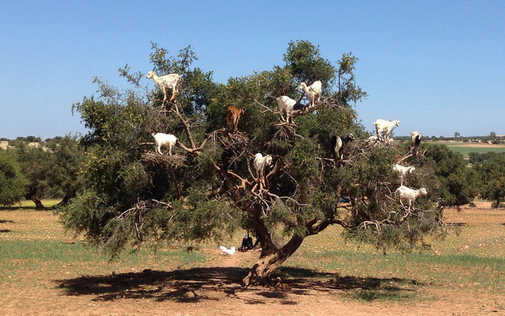
Expression Trees

Slide 7
Expression Trees
How do we construct an expression tree based upon the valid input of our program?
Last Assignment: Infix – Postfix Conversion
Same approach for the tree…
The decision process for pushing and popping operators on and off the operator stack is exactly the same as we had in the Infix-Postfix Conversion….

Slide 8
Expression Trees
This time around we need two stacks, not just one as we need to deal with the Operands as well as the Operators.
Binary Tree – Binary_Op_Command
Helpful Hint(s):
https://www.seas.gwu.edu/~csci133/fall04/133f04trees.html

Slide 9
Visitor Pattern

Slide 10
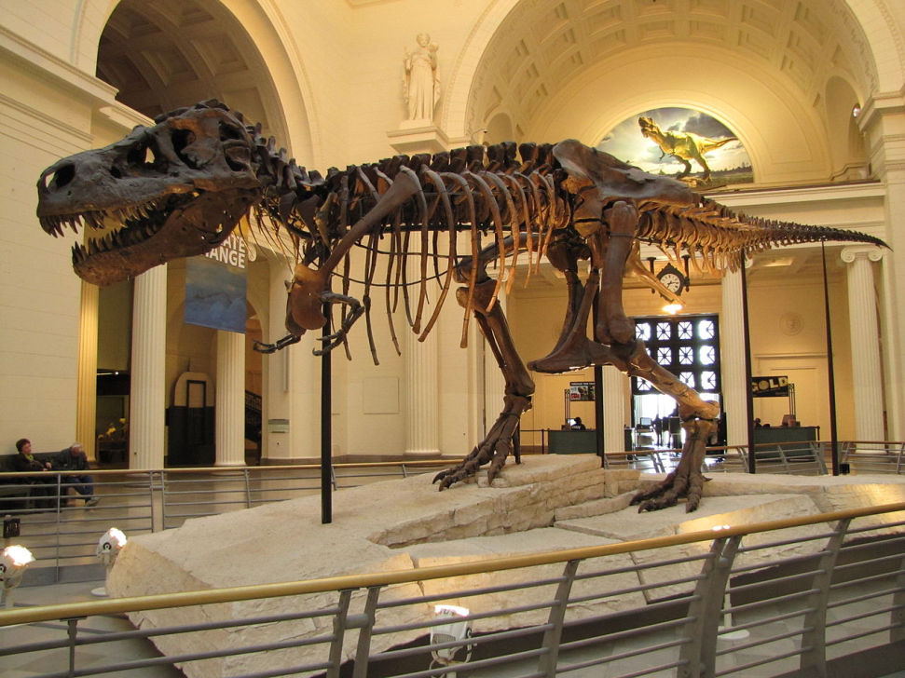
Visitor Pattern
Analogy:
When visiting a museum, how is the museum able to support many different people (i.e., visitation logic) without updating the museum for each person who visits it?
How does it handle this in practice?

Slide 11
Visitor Pattern
Let’s take a look at our Expression Evaluator:
There are many different methods for traversing a tree-structure (e.g., in-order, post-order, pre-order, etc.).
Problem:
How can we provide different methods for traversing the tree without having to update the class definition (or structure) each time?

Slide 12
Visitor Pattern

Slide 13
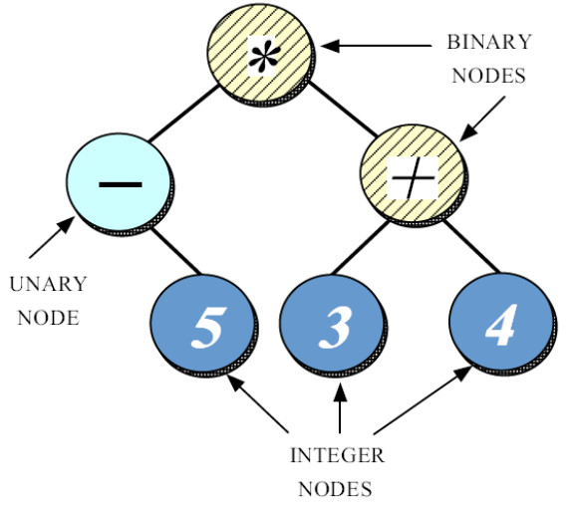
Visitor Pattern
class Expr_Node {
public:
Expr_Node (void);
virtual ~Expr_Node (void);
// Used to traverse the tree
virtual int eval (void) = 0;
virtual void preorder (ostream &) = 0;
};
Each type of tree traversal is given its own method in order to perform its specific behavior.

Slide 14
Visitor Pattern
Pattern Intent:
Represent an operation to be performed on the elements of an object structure.
Visitor lets you define a new operation without changing the classes of the elements on which it operates.
It provides a way to follow the Open/Closed Principle (OCP).

Slide 15
Visitor Pattern
Use When:
An object structure contains many classes of objects with differing interfaces and you want to perform operations on these objects that depend on their concrete classes.
Many distinct and unrelated operations need to be performed on objects in an object structure, and you want to avoid “polluting” their classes with these operations.

Slide 16
Visitor Pattern
Use When:
The classes defining the object structure rarely change, but you often want to define new operations over the structure.
Benefits:
Avoids unnecessary changes.
Avoids “polluting” the classes.
Abstract vs. Concrete

Slide 17
Visitor Pattern
Our current implementation of Expr_Node uses the Composite pattern:
class Expr_Node {
public:
Expr_Node (void);
virtual ~Expr_Node (void);
// Used to traverse the tree
virtual void eval (Expr_Result & r) = 0;
};
The eval () method visits all nodes in the tree using post-order traversal.

Slide 18
Composite Pattern
class Expr_Node {
public:
Expr_Node (void);
virtual ~Expr_Node (void);
// Used to traverse the tree
virtual void eval (Expr_Result & r) = 0;
};
class Expr_Node
Base class for all nodes within the tree.
eval (Expr_Result & r)
This is the “operation” that evaluates each node in the tree (i.e. the composite).

Slide 19
Visitor Pattern
If we want to perform different operations on the expression tree, then we must add the operation to Expr_Node, and implement the operation for each concrete type:
class Expr_Node {
public:
Expr_Node (void);
virtual ~Expr_Node (void);
// Used to traverse the tree
virtual int eval (void) = 0;
virtual void print_preorder (ostream &) = 0;
virtual void print_inorder (ostream &) = 0;
// ...
};

Slide 20
Visitor Pattern
What is the potential problem with the design on the previous slide?
Adding new operations causes the class structure to change.
Consequences:
We have suddenly changed a common dependency and therefore we will need to re-test each individual component in our system.

Slide 21
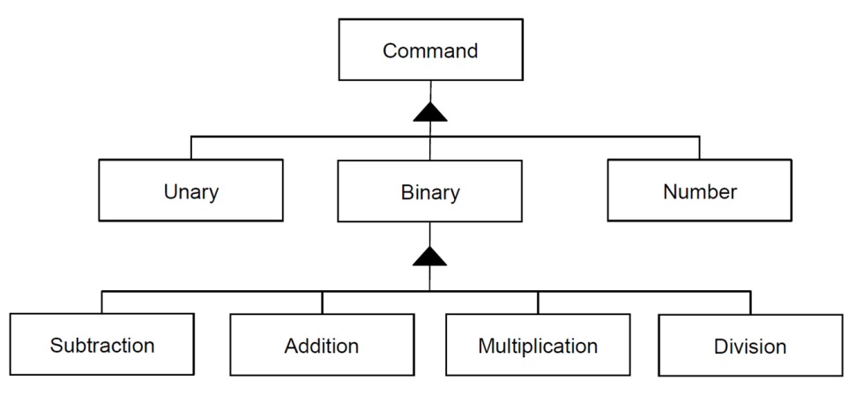
Visitor Pattern
The Visitor pattern can help prevent the class structure from change for each operation that requires traversing the tree.
The Visitor class defines an interface that visits all (concrete) nodes in the structure.

Slide 22
Visitor Pattern
Concrete visitors only overload desired methods:
class Expr_Node_Visitor {
public:
virtual ~Expr_Node_Visitor (void);
// Methods for visiting concrete nodes
virtual void Visit_Addition_Node (const Addition_Node & node);
virtual void Visit_Subtraction_Node (const Subtraction_Node & node);
virtual void Visit_Number_Node (const Number_Node & node);
// ...
};

Slide 23
Visitor Pattern
class Eval_Expr_Tree : public Expr_Node_Visitor {
public:
Eval_Expr_Tree (void);
virtual ~Eval_Expr_Tree (void);
// Methods for visiting concrete nodes
virtual void Visit_Addition_Node (const Addition_Node & node) {
// visit left node, visit right node, then perform addition
}
virtual void Visit_Subtraction_Node (const Subtraction_Node & node);
virtual void Visit_Number_Node (const Number_Node & node);
// ...
int result (void) const { return this->result_; }
private:
int result_;
// other state for calculating result
};

Slide 24
Visitor Pattern
The Eval_Expr_Tree visitor evaluates the expression tree by visiting elements using post-order traversal logic.
Each Visit_* method contains logic for visiting a concrete node.
Calculates the cumulative state of the result.
Returns the result of the evaluation.

Slide 25

Visitor Pattern
How do we convert our tree to a format an infix format such that we can then evaluated it using postfix?
We need some way to convert from an In-Order expression…
But How?

Slide 26
Visitor Pattern
class Print_Inorder_Expression : public Expr_Node_Visitor {
public:
Print_Inorder_Expression (std::ostream & out): out_ (out) { }
virtual ~Print_Inorder_Expression (void);
// Methods for visiting concrete nodes
virtual void Visit_Addition_Node (const Addition_Node & node);
virtual void Visit_Subtraction_Node (const Subtraction_Node & node);
virtual void Visit_Number_Node (const Number_Node & node);
// ...
private:
// output stream
std::ostream out_;
};

Slide 27
Visitor Pattern
The Print_Inorder_Expression visitor prints the expression as an infix expression to the specified output.
This approach can be used for other concrete visitors.
Key:
Print_Inorder_Expression subclasses Expr_Node_Visitor, but contains it own behavior/state.

Slide 28
Visitor Pattern
How do we add Visitor support to our existing classes?
Add an accept () method.
class Expr_Node {
public:
Expr_Node (void);
virtual ~Expr_Node (void);
// Used to traverse the tree
virtual void accept (Expr_Node_Visitor & v) = 0;
};

Slide 29
Visitor Pattern
How do we add Visitor support to our existing classes?
Add an accept () method.
class Addition_Node : Binary_Expr_Node {
public:
// ...
virtual void accept (Expr_Node_Visitor & v) {
v.Visit_Addition_Node (*this);
}
};

Slide 30
Visitor Pattern
How do we then use the Visitor pattern to accomplish our goal?
// ...
Expr_Node * expr_tree = /* get tree from somewhere */
Eval_Expr_Tree eval;
// evaluate the expression tree
expr_tree->accept (eval);
int result = eval.result ();
// print the tree in infix format
Print_Inorder_Expression printer (std::cout);
expr_tree->accept (printer);

Slide 31
Visitor Pattern
Consequences:
Visitors make it easy to add operations that depend on components of complex objects.
A visitor gathers related operations and separates unrelated ones.
Related behavior is localized to the visitor.
Accumulating state
We need to keep “track” of our current location.
Without a Visitor this state would need to be either passed as another variable or global – bad ☹.

Slide 32
Visitor Pattern
Consequences:
Adding new concrete element classes is hard!
We have to update the interface for each new concrete object.
Visiting across class hierarchies.
Visitor still functions as expected – does not depend on inheritance.
class A;
class B;
class Visitor {
public:
virtual void Visit_A (A & a);
virtual void Visit_B (B & b);
};

Slide 33
Visitor Pattern
Consequences:
Can compromise encapsulation.
May have to expose the internal state of A and B to visit its children.
class A;
class B;
class Visitor {
public:
virtual void Visit_A (A & a);
virtual void Visit_B (B & b);
};

Slide 34
Visitor Pattern
The following are implementation issues that arise when implementing the Visitor pattern:
Double Dispatch
Code Smell – Violates Open/Closed Principle (OCP)
class A : public Visitable {
virtual void Accept (V & v) {
v.Visit_A (*this);
}
}
class Visitor {
public:
virtual void Visit_A (A & a);
};

Slide 35
Visitor Pattern
Double Dispatch
The operation that gets executed depends on the kind of request and the types of the two receives.
Accept is an example as shown on the previous slide of a double dispatch operation.
It depends on two types: the Visitor’s and the Element’s.
Lets visitors request different operations on each class of element.
Key aspect of the Visitor pattern!

